Slide 1

Predicting Customer Buying Behavior
KEHINDE OLALEKAN – DATA SCIENTIST
09/05/2025

Slide 2

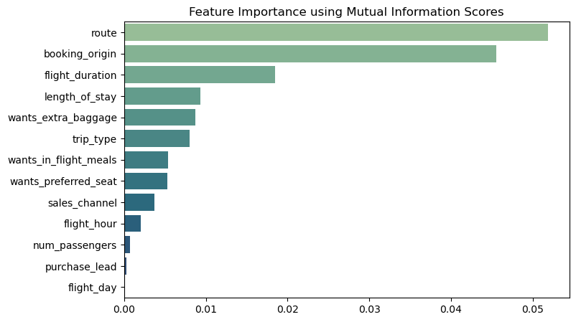
predictive model to understand factors that influence buying behavior
The data was trained using Random Forest Classifier model and the result :
Training Accuracy – 99.98%
Validation Accuracy – 85.17%
Top 5 features that influenced the customer buying behaviors are:
Route
Booking Origin
Flight duration
Length of stay
Wants extra baggage

